Slide 1

Data Service Server
Anonymous

Slide 2
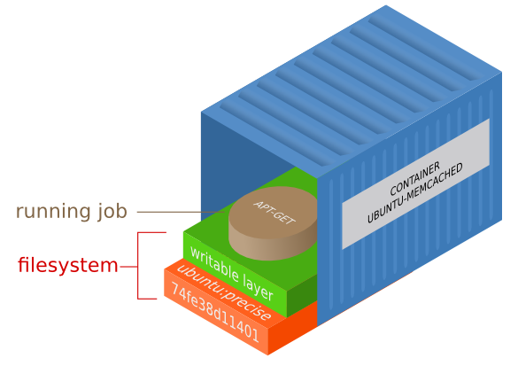
Brief In Containers
https://medium.com/@nagarwal/best-practices-for-working-with-dockerfiles-fb2d22b78186

Slide 3
Runtime Environment - Originally
App
bins/libs
Operating System

Slide 4
Runtime Environment - Originally
App
App
App
bins/libs
bins/libs
bins/libs
Operating System
Operating System

Slide 5
Runtime Environment - Originally
App
App
App
bins/libs
bins/libs
bins/libs
Operating System
Operating System

Slide 6
Runtime Environment - Originally
App
App
App
bins/libs
bins/libs
bins/libs
Operating System
Operating System

Slide 7
Runtime Environment - Virtualization
App
App
bins/libs
bins/libs
Operating System
(Guest)
Operating System
(Guest)
Hypervisor
Operating System
(Host)

Slide 8
Runtime Environment - Containerization
App
App
bins/libs
bins/libs
Container Runtime
(Docker / rkt)
Operating System

Slide 9
Runtime Environment - Containerization
App
App
App
App
bins/libs
bins/libs
bins/libs
bins/libs
Container Runtime
(Docker / rkt)
Operating System

Slide 10
Runtime Environments Comparison
Virtual Machines | Containers
Heavyweight | Lightweight
Limited performance | Native performance
Each VM runs its own OS | All containers share the host OS
Hardware-level virtualization | OS virtualization
Startup time in minutes | Startup time in milliseconds
Allocates required memory | Requires less memory space
Fully isolated, hence more secure | Process-level isolation, possibly less secure

Slide 11
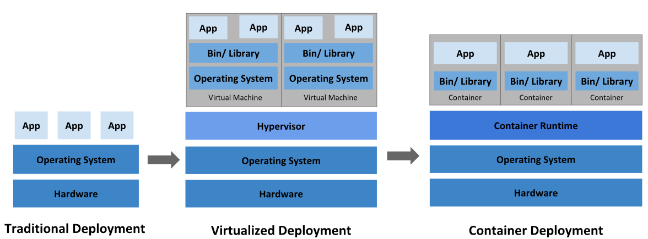
Deployment Evolution

Slide 12
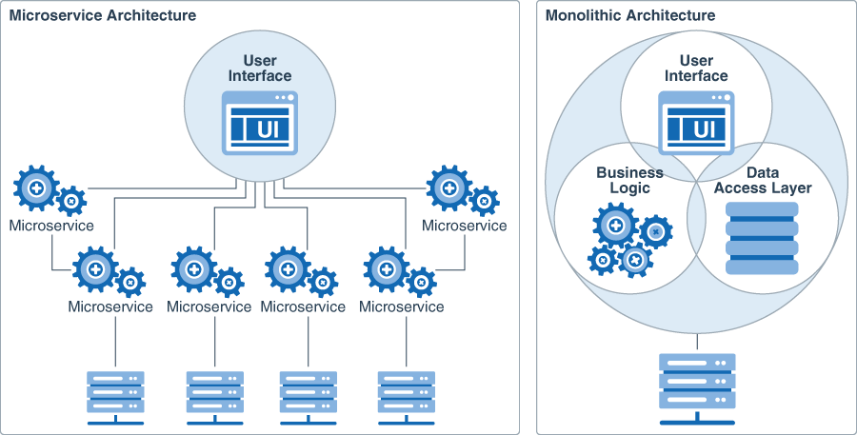
Microservice VS Monolithic Architecture

Slide 13
NGINX With Docker
Search container image on Docker Hub (https://hub.docker.com)
Start the container via docker CLI $ docker run --name nginx -p 80:80 -d nginx
Hit it in a browser, or via curl CLI (http://your-ip)
Stop the container via docker CLI $ docker stop nginx
Argument | Description
docker run | Starts a docker container up
--name alex-nginx | Assign a name to the container
-p 80:80 | Publish a container's port(s) to the host
-d | Run container in background
nginx | Image name

Slide 14
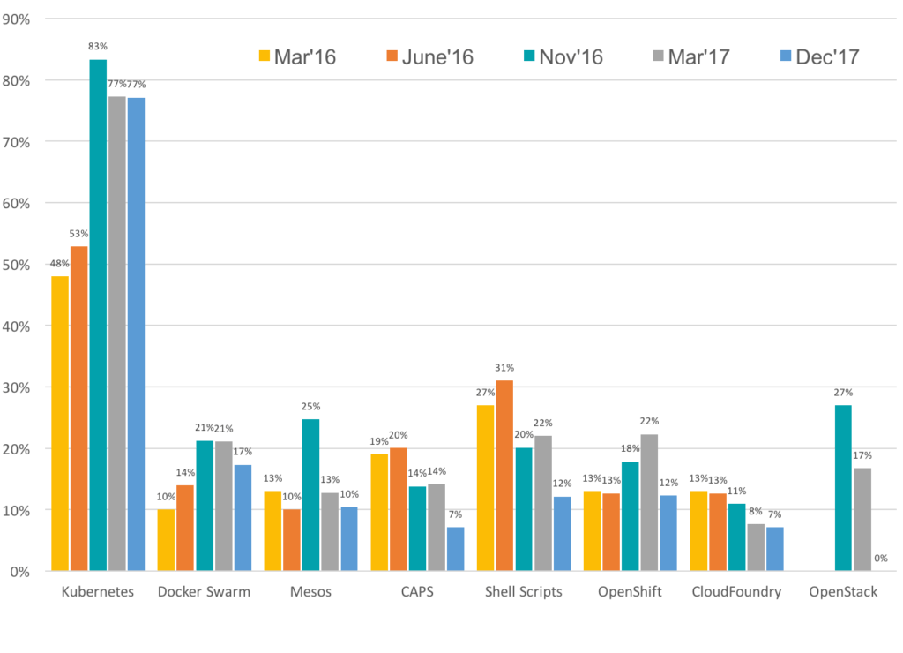
The Evolving Landscape of Container Management Platforms

Slide 15
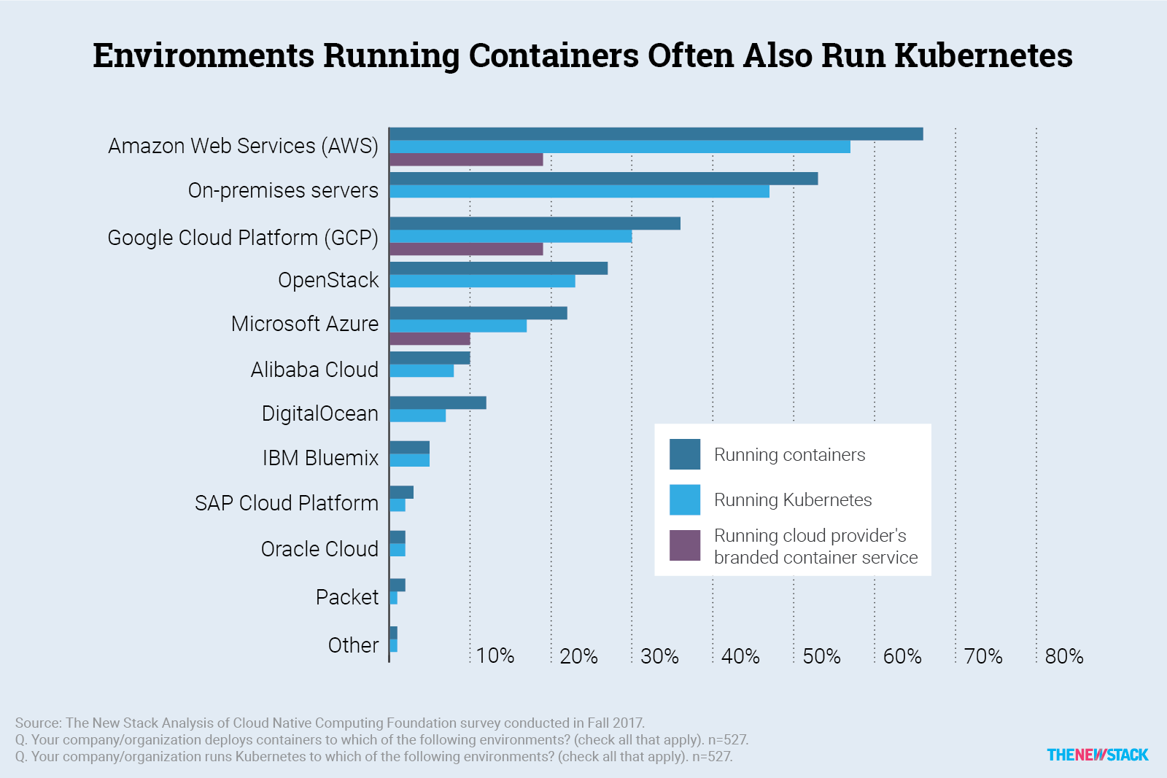

Slide 16
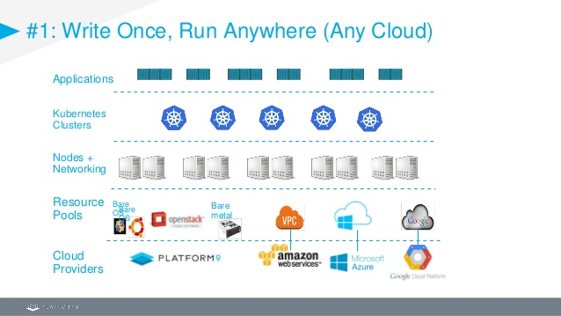

Slide 17
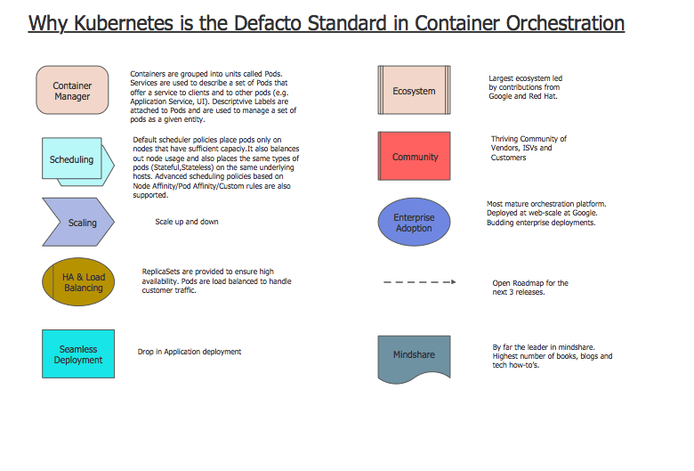

Slide 18

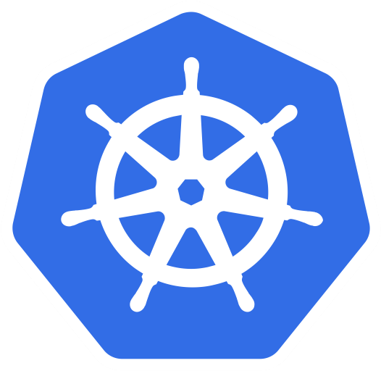
What Is Kubernetes (aka k8s)?
https://technologyadvice.com/blog/information-technology/kubernetes-vs-docker

Slide 19
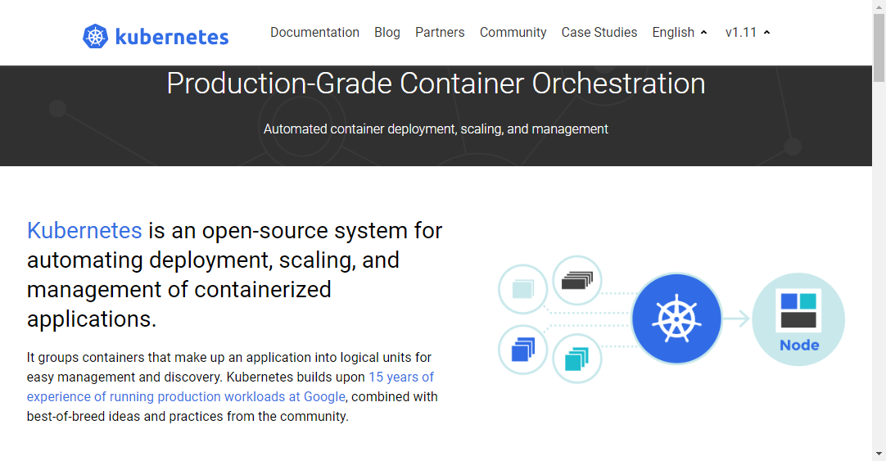
Kubernetes is
Production-Grade container orchestration.
An open-source system for automating deployment, scaling, and management of containerized applications.
https://kubernetes.io

Slide 20
NGINX With Kubernetes
Search container image on Docker Hub (https://hub.docker.com)
Define a pod YAML file
Run it onto Kunerbetes: $ kubectl create -f pod.yaml
Create a service for it: $ kubectl create -f service.yaml
Hit it in a browser, or via curl CLI $ curl http://your-ip
Stop it from Kubernetes $ kubectl delete -f pod.yaml service.yaml
Notes:
$ kubectl create -f 02_nginx-with-k8s/pod.yaml
$ kubectl get pods -o wide
$ ssh lab-k[123]
$ curl http://<IP>
<CTRL><D>
$ kubectl delete -f 02_nginx-with-k8s/pod.yaml

Slide 21

Kubernetes Architecture Overview
https://brick.com/original-%E2%80%9Cgreen%E2%80%9D-building-material-brick

Slide 22
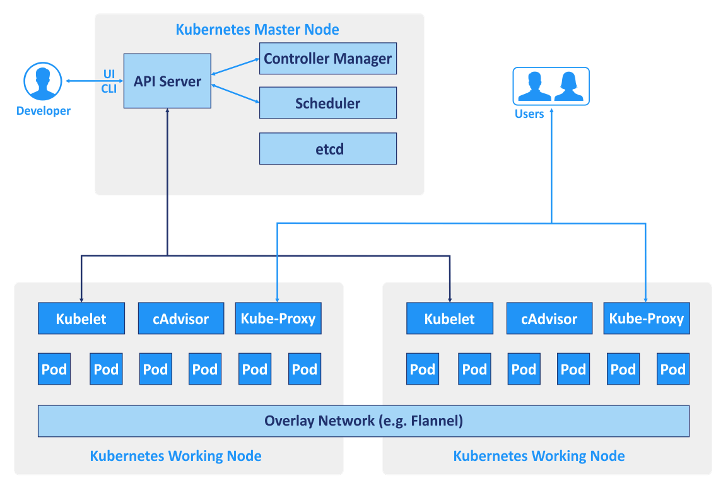
The Kubernetes architecture and scalability
Notes:
K8S為cluster的架構上面有master和node
Master為cluster的核心掌管cluster資源如何分配包含部屬的app要放在哪一台node上面
監控這些app是否正常
API server為認證kube ctrl command的地方，去管理user是否有權限做後續的操作
Controller manager及scheduler是掌管資源分配給哪一個node使用
Etcd為DB包含app放置在那些位置，export出來那些port，所有資源都會記錄在etcd內
Node內會有Kubelet的component負責接收master下達的指令
Cadvisor是監控node資源
Kubeproxy是node之間做溝通或是export service導出來給外面的user使用

Slide 23
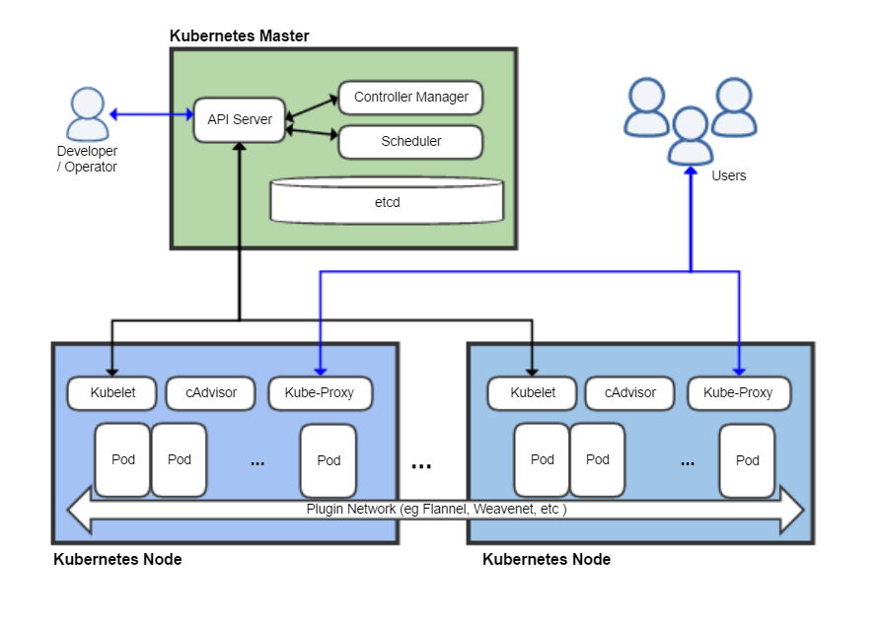
Kubernetes Architecture
Master (aka control plane)
The main controlling unit of the cluster that manages its workload and directs communication across the system.
Can run both on a single master node or on multiple masters supporting high-availability clusters.
Worker node (aka Minion)
A machine where containers (workloads) are deployed.
Every node in the cluster must run a container runtime such as Docker.

Slide 24
Kubernetes Components - Master
etcd
Consistent and highly-available key value store used as Kubernetes’ backing store for all cluster data.
API server
Component on the master that exposes the Kubernetes API. It is the front-end for the Kubernetes control plane.
Scheduler
Component on the master that watches newly created pods that have no node assigned, and selects a node for them to run on.
Controller manager
Component on the master that runs controllers.

Slide 25
Kubernetes Components - Node
Kubelet
An agent that runs on each node in the cluster. It makes sure that containers are running in a pod.
Kube-proxy
Enables the Kubernetes service abstraction by maintaining network rules on the host and performing connection forwarding.
Container runtime
The software that is responsible for running containers. Kubernetes supports several runtimes: Docker, rkt, runc and any OCI runtime-spec implementation.

Slide 26

How To Talk To Kubernetes?
https://sahabatnesia.com/unsur-unsur-komunikasi/

Slide 27
Kubernetes Command Line Interfaces
minikube
A tool that makes it easy to run Kubernetes locally.
kubeadm
It performs the actions necessary to get a minimum viable cluster up and running. By design, it cares only about bootstrapping, not about provisioning machines.
kops
Helps you create, destroy, upgrade and maintain production-grade, highly available, Kubernetes clusters from the command line.
AWS (Amazon Web Services) is currently officially supported, with GCE in beta support , and VMware vSphere in alpha, and other platforms planned.
kubectl
A command line interface for running commands against Kubernetes clusters.
create, delete, exec, get, logs, replace

Slide 28

Concepts In Kubernetes
https://study.com/academy/course/fundamental-chemistry.html

Slide 29
Kubernetes Concepts
Essential
Pod
Label
Service
ReplicaSet (manipulated by Deployment)
Deployment
Advanced
More about Pod
ConfigMap
Secrets
StatefulSet
DaemonSet

Slide 30

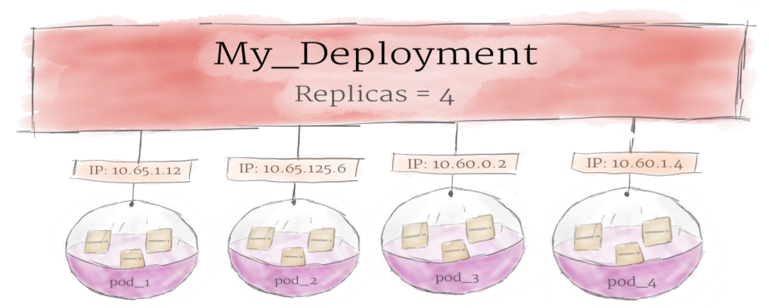

Essential Concepts In Kubernetes
container
Deployment
Pod
https://medium.com/google-cloud/kubernetes-101-pods-nodes-containers-and-clusters-c1509e409e16

Slide 31
Kubernetes Concept - Pod
The smallest and simplest unit in the Kubernetes object model that you create or deploy.
Contains one or more containers, with shared storage/network, and a specification for how to run the containers. In a pre-container world, they would have executed on the same physical or virtual machine.
Every container in a pod shares
Network namespace, including the IP address and network ports. That is, they can communicate with one another using localhost.
Storage volumes. All containers in the Pod can access the shared volumes, allowing those containers to share data.

Slide 32
Pod
01 02 03 04 05 06 07 08 | kind: Pod apiVersion: v1 metadata: name: nginx spec: containers: - name: nginx image: nginx
$ kubectl create -f 03_pod/pod.yaml
$ kubectl get pods -o wide --show-labels
Notes:
$ kubectl create -f 03_pod/pod.yaml
$ kubectl get pods -o wide --show-labels
$ ssh lab-k[123]
$ curl http://<IP>
<CTRL><D>
$ kubectl delete -f 03_pod/pod.yaml
===============================
*** Re-create again to see the allocated IP, it should be different from the last one. This is why we introduce Service next!!!

Slide 33
Kubernetes Concept - Service
An abstraction which defines a logical set of Pods and a policy by which to access them - sometimes called a micro-service.
Is usually determined by a Label Selector.
Support 4 types:
ClusterIP
Exposes the service on a cluster-internal IP. ClusterIP makes the service only reachable from within the cluster. This is the default type.
NodePort
Exposes the service on each node’s IP at a static port (default port range 30000-32767). You’ll be able to contact the service, from outside the cluster, by requesting <NodeIP>:<NodePort>.
LoadBalancer
Exposes the service externally using a cloud provider’s load balancer.
ExternalName (requires kube-dns version 1.7 above)
Maps the service to the contents of the externalName field (e.g. foo.bar.example.com), by returning a CNAME record with its value.

Slide 34
Service, NodePort
01 02 03 04 05 06 07 08 09 10 11 12 13 | kind: Service apiVersion: v1 metadata: name: web-server spec: type: NodePort selector: app: nginx-server ports: - protocol: TCP port: 80 targetPort: 80 # specific, no random nodePort: 32109
01 02 03 04 05 06 07 08 09 10 | kind: Pod apiVersion: v1 metadata: name: nginx labels: app: nginx-server spec: containers: - name: nginx image: ecgwc/http-server
$ kubectl create -f 04_service-nodeport/pod.yaml
$ kubectl create -f 04_service-nodeport/service.yaml
$ kubectl get services -o wide
$ curl http://61.218.118.227:32109
Notes:
$ kubectl create -f 04_service/pod.yaml
$ kubectl create -f 04_service/node-port.yaml
$ kubectl get services -o wide
$ curl http://61.218.118.22[789]:32109
============================
$ kubectl delete -f 04_service/pod.yaml
$ kubectl create -f 04_service/pod.yaml
$ curl http://61.218.118.22[789]:32109
============================
$ kubectl exec nginx -it -- bash # to enter the container
# curl http://web-server
# curl http://web-server:32109
============================
$ kubectl delete -f 04_service/node-port.yaml
$ vi 04_service/node-port.yaml # remove [nodePort]
$ kubectl create -f 04_service/node-port.yaml # to see the random generated port number

Slide 35
Kubernetes Concept - Deployment
A deployment provides declarative updates for Pods and ReplicaSets.
Normally used for stateless applications.
Manage updating and scaling with ease.

Slide 36
Deployment
01 02 03 04 05 06 07 08 09 10 11 12 13 14 15 16 17 18 1920 21 22 23 24 | kind: Deployment apiVersion: apps/v1 metadata: name: nginx-cluster spec: replicas: 5 # how many pods to run selector: matchLabels: app: nginx strategy: type: RollingUpdate rollingUpdate: maxSurge: 3 # default value is 25% maxUnavailable: 1 # default value is 25% template: metadata: labels: app: nginx spec: containers: - name: nginx image: ecgwc/http-server:1.0.0 ports: - containerPort: 80
Notes:
$ kubectl create -f 05_deployment/deployment.yaml
$ kubectl create -f 05_deployment/service.yaml
$ kubectl get pods
=======================
http://61.218.118.227:32109 # F5 to see IP
=======================
$ kubectl delete pod xxxxx # to see k8s create another one automatically
=======================
$ vi 05_deployment/deployment.yaml # change replicas from 5 to 10
$ kubectl replace -f 05_deployment/deployment.yaml
$ vi 05_deployment/deployment.yaml # remove 1.0.0 version
$ kubectl replace -f 05_deployment/deployment.yaml # to see rolling update

Slide 37
Kubernetes Concept - More About Pod
Init containers
Always run to completion.
Each one must complete successfully before the next one is started.
Volume - emptyDir
Created when a Pod is assigned to a node, and exists as long as that Pod is running on that node.
Containers in the Pod can all read and write the same files in the emptyDir volume.
When a Pod is removed from a node for any reason, the data in the emptyDir is deleted forever.
Volume - hostPath
Mounts a file or directory from the host node’s filesystem into the Pod.
Accessing to Docker internals (/var/lib/docker)
Volume – rbd
An rbd volume allows a Rados Block Device volume to be mounted into your Pod. Unlike emptyDir, which is erased when a Pod is removed, the contents of a rbd volume are preserved and the volume is merely unmounted. This means that a RBD volume can be pre-populated with data, and that data can be “handed off” between Pods.

Slide 38
Init Containers
01 02 03 04 05 06 07 08 09 10 11 12 13 14 15 16 17 | kind: Pod apiVersion: v1 metadata: name: myapp-pod labels: app: myapp spec: containers: - name: nginx image: nginx initContainers: - name: init-myservice image: alpine command: ['sh', '-c', 'until nslookup myservice; do echo waiting for myservice; sleep 2; done;'] - name: init-mydb image: alpine command: ['sh', '-c', 'until nslookup mydb; do echo waiting for mydb; sleep 2; done;']
Notes:
$ kubectl create -f 06_init-containers/pods.yaml
$ kubectl get all -o wide
$ kubectl describe -f 06_init-containers/pods.yaml
$ kubectl logs myapp-pod -c init-myservice -f # should be waiting for init
================================
$ kubectl create -f 06_init-containers/service.yaml

Slide 39
Persistent Volumes (PV/PVC)
PersistentVolume (PV)
is a piece of storage in the cluster that has been provisioned by an administrator or dynamically provisioned using Storage Classes.
PersistentVolumeClaim (PVC)
is a request for storage by a user. It is similar to a pod. Pods consume node resources and PVCs consume PV resources.

Slide 40
PVC
01 02 03 04 05 06 07 08 09 10 11 12 13 14 15 16 17 18 19 20 21 | apiVersion: v1 kind: PersistentVolumeClaim metadata: labels: app: minio chart: minio-2.3.8 heritage: Tiller release: es-minio name: es-minio namespace: default spec: accessModes: - ReadWriteOnce resources: requests: storage: 128Gi storageClassName: rbd
Notes:
$ kubectl -f 07_volume/empty-dir.yaml
$ kubectl get pods -o wide
$ kubectl exec -it empty-dir -c nginx -- bash # watch /N1
$ kubectl exec -it empty-dir -c mysql -- bash # watch /N2

Slide 41
hostPath
01 02 03 04 05 06 07 08 09 10 11 12 13 14 15 16 | kind: Pod apiVersion: v1 metadata: name: host-path spec: containers: - name: nginx image: nginx volumeMounts: - mountPath: /ZZZ name: test-volume volumes: - name: test-volume hostPath: path: /etc type: Directory
Reference
https://v1-10.docs.kubernetes.io/docs/concepts/storage/volumes/
Notes:
$ kubectl create -f 07_volume/host-path.yaml
$ kubectl get all -o wide
$ kubectl exec -it host-path -- bash # Check /ZZZ dir

Slide 42
emptyDir
01 02 03 04 05 06 07 08 09 10 11 12 13 14 15 16 17 18 19 20 21 22 | kind: Pod apiVersion: v1 metadata: name: empty-dir spec: containers: - name: nginx image: nginx volumeMounts: - mountPath: /N1 name: cache-volume - name: mysql image: mysql volumeMounts: - mountPath: /N2 name: cache-volume env: - name: MYSQL_ROOT_PASSWORD value: root2@sx volumes: - name: cache-volume emptyDir: {}
Notes:
$ kubectl -f 07_volume/empty-dir.yaml
$ kubectl get pods -o wide
$ kubectl exec -it empty-dir -c nginx -- bash # watch /N1
$ kubectl exec -it empty-dir -c mysql -- bash # watch /N2

Slide 43
Kubernetes Concept - ConfigMap
Decouple configuration artifacts from image content to keep containerized applications portable.
Use cases are
Pod environment variables.
Configuration files used by applications.

Slide 44
ConfigMap (environment variables)
01 02 03 04 05 06 07 | kind: ConfigMap apiVersion: v1 metadata: name: cm-env data: SPECIAL_LEVEL: very SPECIAL_TYPE: charm
01 02 03 04 05 06 07 08 09 10 11 12 13 14 15 16 17 18 19 20 21 22 | kind: Pod apiVersion: v1 metadata: name: cm-pod spec: containers: - name: nginx image: nginx envFrom: - configMapRef: name: cm-env env: - name: ALEX_LEVEL valueFrom: configMapKeyRef: name: cm-env key: SPECIAL_LEVEL - name: ALEX_TYPE valueFrom: configMapKeyRef: name: cm-env key: SPECIAL_TYPE
Notes:
$ kubectl create -f 08_config-map/env.yaml
$ kubectl get all -o wide
$ kubectl exec -it cm-pod -- bash
## check all available environment variables

Slide 45
ConfigMap (configuration file)
01 02 03 04 05 06 07 08 09 10 11 12 13 | kind: ConfigMap apiVersion: v1 metadata: name: server-config data: config: | <?xml version="1.0" encoding="UTF-8"?> <Configuration> <WebServer> <IP>127.0.0.1</IP> <HTTPPort>8080</HTTPPort> </WebServer> </Configuration>
01 02 03 04 05 06 07 08 09 10 11 12 13 14 15 16 17 18 | kind: Pod apiVersion: v1 metadata: name: cm-pod spec: containers: - name: nginx image: nginx volumeMounts: - name: config mountPath: /etc/rmm volumes: - name: config configMap: name: server-config items: - key: config path: Server_Config.xml
Configuration can be dynamically changed by such means.
Notes:
$ kubectl create -f 08_config-map/configuration.yaml
$ kubectl exec -it cm-pod -- bash
# cd /etc/rmm
# cat Server_Config.xml
==================
$ kubectl replace -f 08_config-map/new-configuration.yaml
$ kubectl exec -it cm-pod -- bash
# while true; do cat /etc/rmm/Server_Config.xml; sleep 2; done

Slide 46
Kubernetes Concept - Secret
A Secret is an object that contains a small amount of sensitive data such as a password, a token, or a key.
Can be used
As files from a Pod.
From environment variables.

Slide 47
Secret
01 02 03 04 05 06 07 08 09 10 11 12 13 14 15 16 17 18 19 20 21 22 23 24 25 | kind: Pod apiVersion: v1 metadata: name: secret-pod spec: containers: - name: nginx image: nginx env: - name: LOGIN_PASSWD valueFrom: secretKeyRef: name: credential key: password volumeMounts: - name: secret-volume mountPath: /etc/secret readOnly: true volumes: - name: secret-volume secret: secretName: credential items: - key: username path: login/username
01 02 03 04 05 06 07 08 09 10 | kind: Secret apiVersion: v1 type: Opaque metadata: name: mysecret data: # echo -n 'admin' | base64 username: YWRtaW4= # echo -n ‘P@ssw0rd' | base64 password: UEBzc3cwcmQ=
Notes:
$ kubectl create -f 09_secret/partial.yaml
$ kubectl exec -it secret-pod -- bash
# echo $LOGIN_PASSWD
# cd /etc/secret
# ls
# more login/username
# kubectl delete -f 09_secret/partial.yaml
==============================
$ kubectl create -f 09_secret/all.yaml
$ kubectl exec -it secret-pod -- bash
# echo $LOGIN_PASSWD
# cd /etc/secret
# ls
# more username
# more password

Slide 48
Kubernetes Concept - StatefulSet
Used for applications that require
Persistence unique network identifiers across Pod (re)scheduling.
Persistence storage across Pod (re)scheduling.
Ordered deployment and scaling, deletion and termination, automated rolling updates.
Limitations
The storage for a given Pod must either be provisioned by a PersistentVolume Provisioner based on the requested storage class, or pre-provisioned by an admin.
Require a Headless Service to be responsible for the network identity of the Pods.
Examples
MongoDB https://wiki.shileizcc.com/confluence/pages/viewpage.action?pageId=27000909
Cassandra https://v1-10.docs.kubernetes.io/docs/tutorials/stateful-application/cassandra/
ZooKeeper https://v1-10.docs.kubernetes.io/docs/tutorials/stateful-application/zookeeper/

Slide 49
Kubernetes Concept - DaemonSet
A DaemonSet ensures that all nodes run a copy of a Pod. As nodes are added to the cluster, Pods are added to them. As nodes are removed from the cluster, those Pods are garbage collected. Deleting a DaemonSet will clean up the Pods it created.
Typical use cases are
Running a cluster storage daemon, such as glusterd, ceph, on each node.
Running a logs collection daemon on every node, such as fluentd or logstash.
Running a node monitoring daemon on every node, such as Prometheus Node Exporter, collectd, Datadog agent, New Relic agent, or Ganglia gmond.
Examples
Fluentd https://v1-10.docs.kubernetes.io/docs/concepts/workloads/controllers/daemonset/#writing-a-daemonset-spec

Slide 50

What’s Next?
https://www.ecampusnews.com/2018/03/23/whats-next-higher-ed/

Slide 51
Others
Dockerfile
Provide the instructions to build container image automatically.
Ingress
Manages external access to the services in a cluster, typically HTTP.
Role-Based Access Control (RBAC)
A method of regulating access to computer or network resources based on the roles of individual users within an enterprise.
Helm
A package manager for Kubernetes, analogous to Yum or Apt.
Repositories
Ceph

Slide 52

Dockerfile

Slide 53
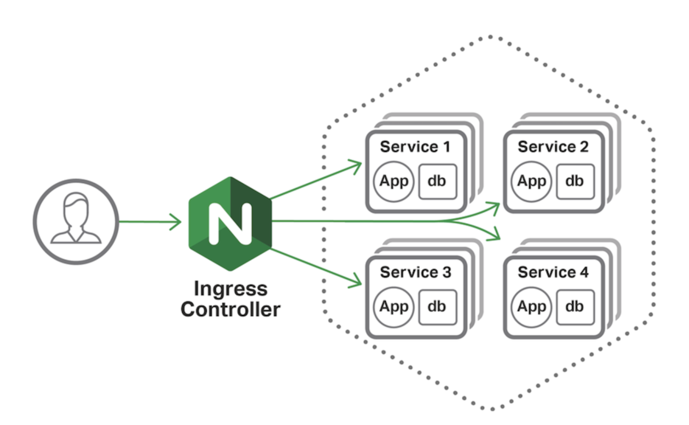
Nginx-Ingress

Slide 54
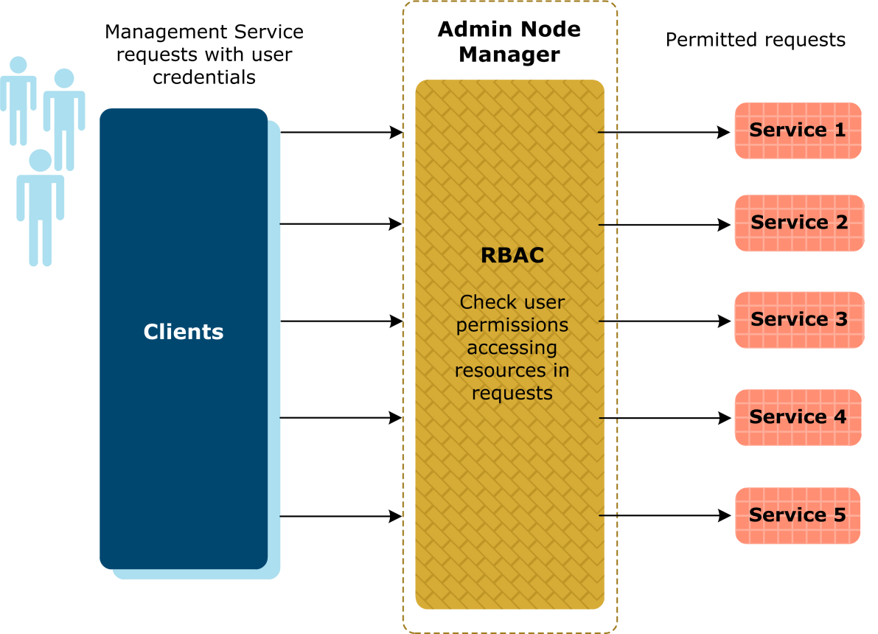
RBAC

Slide 55

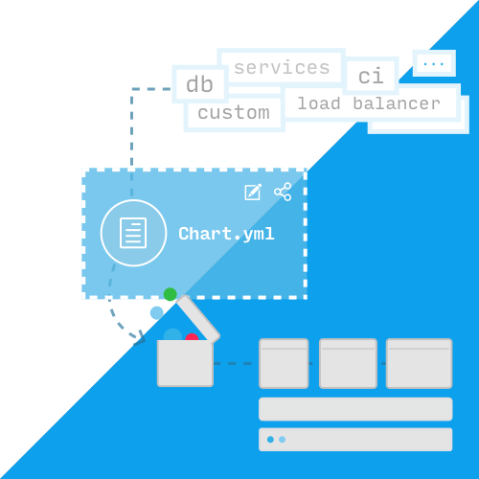
Helm
Helm
Making container-based applications easier to deploy on Kubernetes.
creating a package manager for Kubernetes applications.
make installing new applications on Kubernetes as easy as running helm install <chart-name>.

Slide 56
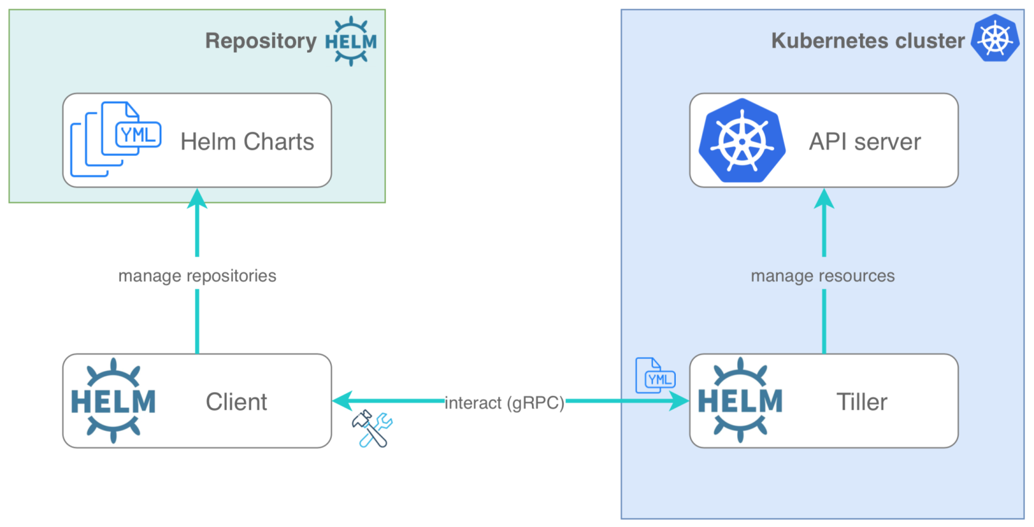
Repository

Slide 57
Ceph
Ceph (pronounced /ˈsɛf/) is a free-software storage platform, implements object storage on a single distributed computer cluster, and provides interfaces for object-, block- and file-level storage. Ceph aims primarily for completely distributed operation without a single point of failure, scalable to the exabyte level, and freely available.
Ceph replicates data and makes it fault-tolerant,^{[7]} using commodity hardware and requiring no specific hardware support. As a result of its design, the system is both self-healing and self-managing, aiming to minimize administration time and other costs.

Slide 58
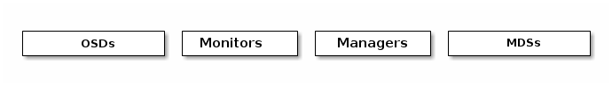
Ceph
Monitors: A Ceph Monitor (ceph-mon) maintains maps of the cluster state, including the monitor map, manager map, the OSD map, the MDS map, and the CRUSH map. These maps are critical cluster state required for Ceph daemons to coordinate with each other. Monitors are also responsible for managing authentication between daemons and clients. At least three monitors are normally required for redundancy and high availability.
Managers: A Ceph Manager daemon (ceph-mgr) is responsible for keeping track of runtime metrics and the current state of the Ceph cluster, including storage utilization, current performance metrics, and system load. The Ceph Manager daemons also host python-based modules to manage and expose Ceph cluster information, including a web-based Ceph Dashboard and REST API. At least two managers are normally required for high availability.

Slide 59
Ceph
Ceph OSDs: A Ceph OSD (object storage daemon, ceph-osd) stores data, handles data replication, recovery, rebalancing, and provides some monitoring information to Ceph Monitors and Managers by checking other Ceph OSD Daemons for a heartbeat. At least 3 Ceph OSDs are normally required for redundancy and high availability.
MDSs: A Ceph Metadata Server (MDS, ceph-mds) stores metadata on behalf of the Ceph File System (i.e., Ceph Block Devices and Ceph Object Storage do not use MDS). Ceph Metadata Servers allow POSIX file system users to execute basic commands (like ls, find, etc.) without placing an enormous burden on the Ceph Storage Cluster.

Slide 60
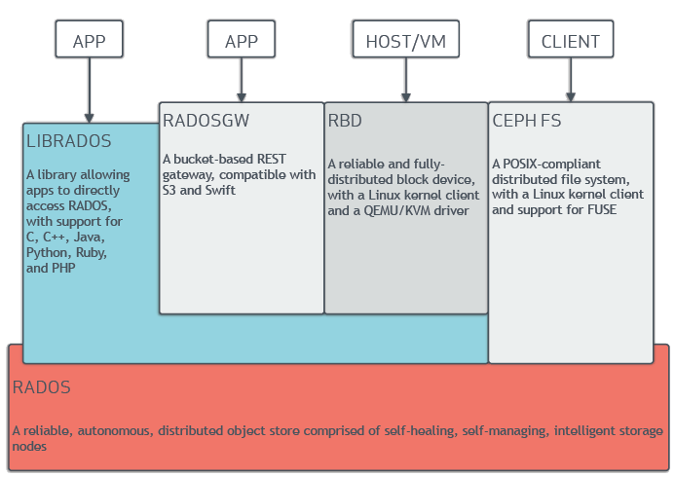
Notes:
https://juejin.im/entry/5c3c19466fb9a049db735f2d

Slide 61
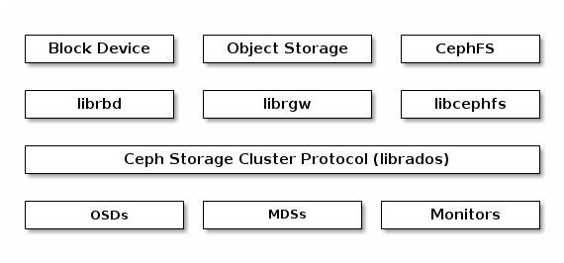

Slide 62
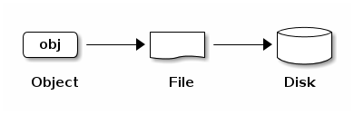
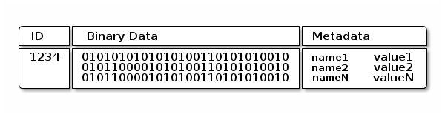

Slide 63
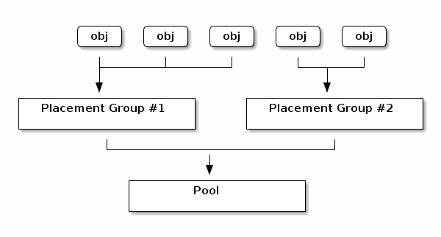
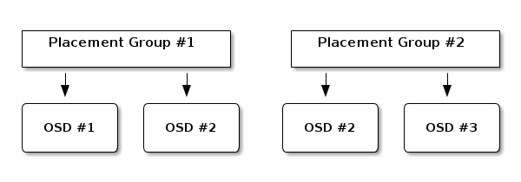
Notes:
https://docs.ceph.com/docs/mimic/rados/operations/placement-groups/

Slide 64
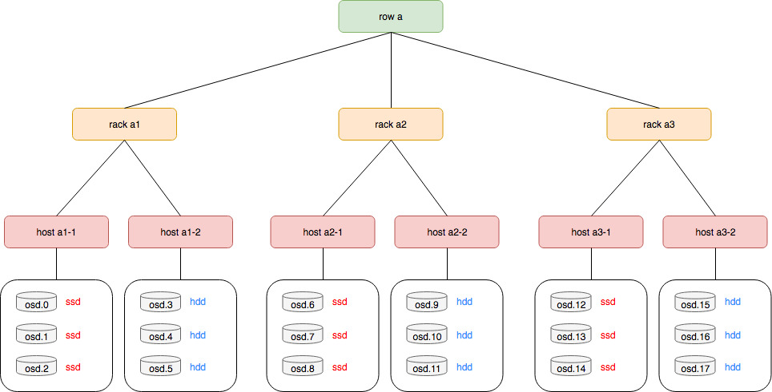

Slide 65
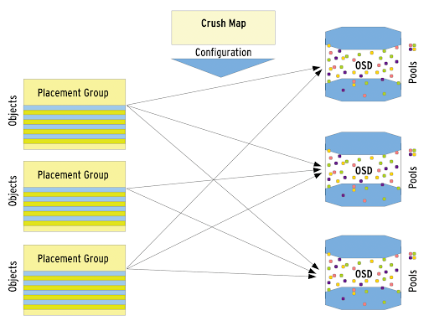

Slide 66
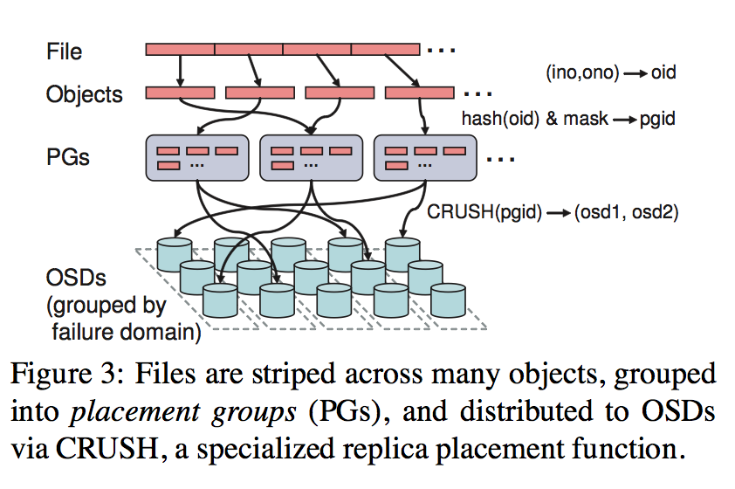

Slide 67
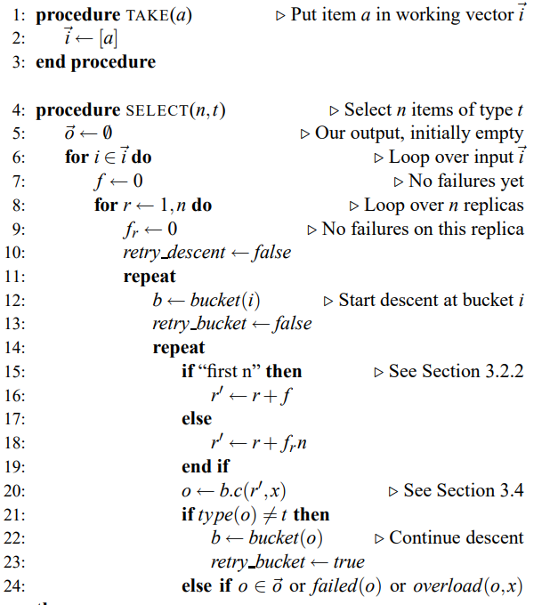
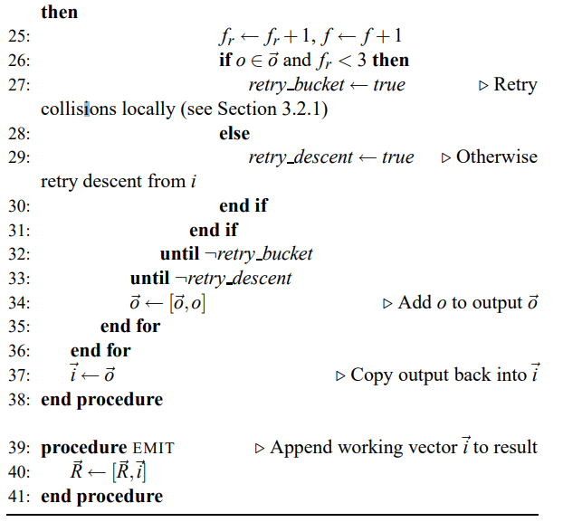

Slide 68
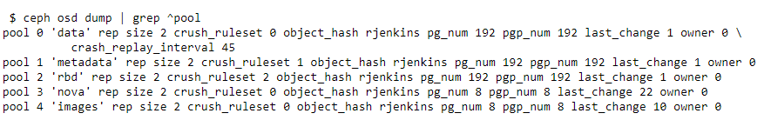

Slide 69
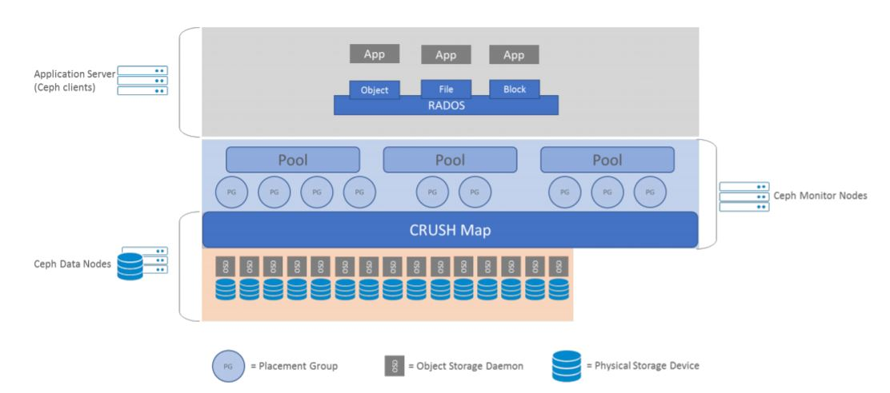

Slide 70




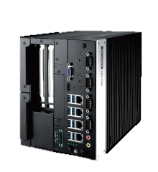


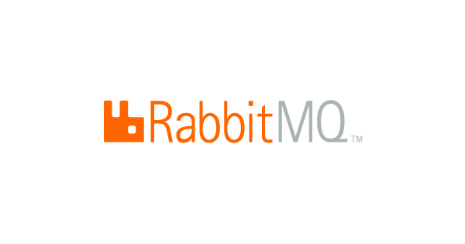




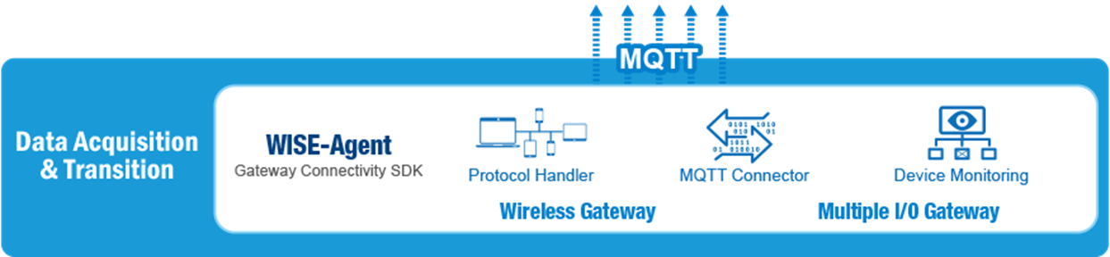
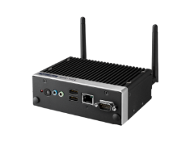


Data Service Server Architecture
Device management
Data Visualization
Data
Service
Package
Self-Healing
App Repository
Auto Scaling
Load Balancing
Backend Server Management
IoT Hub
Data Base Management
Edge Computing

Slide 71

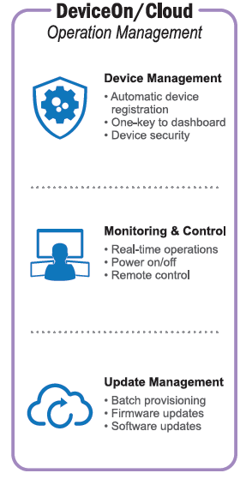


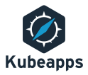

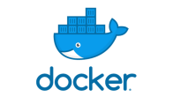
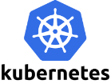
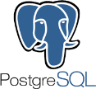
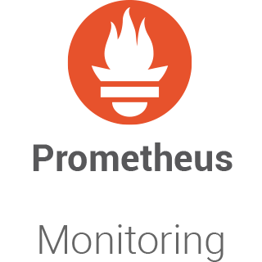
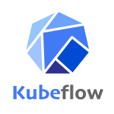

Software Stack
Platform Management
Applications
Message Broker
Data Visualization
Lightweight and easy to deploy on premises and in the cloud. It supports multiple messaging protocols..
Allows you to query, visualize, alert on and understand your metrics.
App Management
Backend Management
Kubeapps is a web-based UI for deploying and managing applications in Kubernetes clusters.
The Docker Registry is a stateless, highly scalable server side application that stores and lets you distribute Docker images.
ChartMuseum is an Helm Chart Repository server written in Go. It provides an API for uploading charts.
Runs on top of the same object storage system that provides object storage and block device interfaces.
Deployment, scaling, and management of containerized applications.
Database Management
A powerful, open source object-relational database system.
Prometheus is an open-source software application used for event monitoring and alerting.
MongoDB is a document database, which means it stores data in JSON-like documents.
Machine Learning
Making deployments of machine learning (ML) workflows on Kubernetes Device Management
Notes:
Check health status of services and heal them in need.

Slide 72
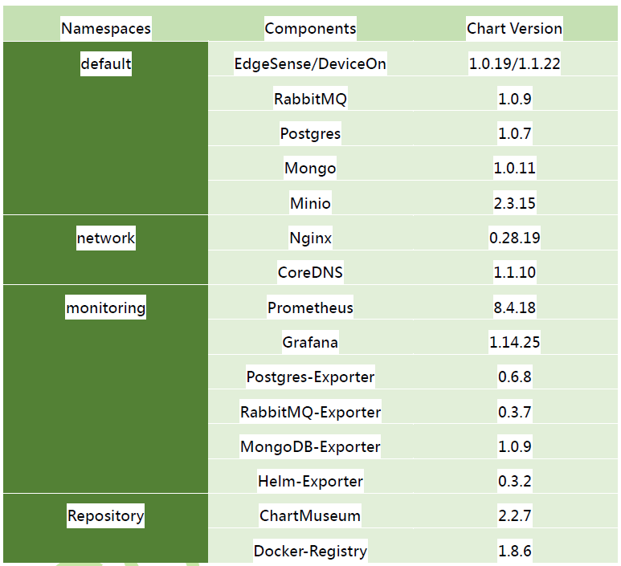

Slide 73
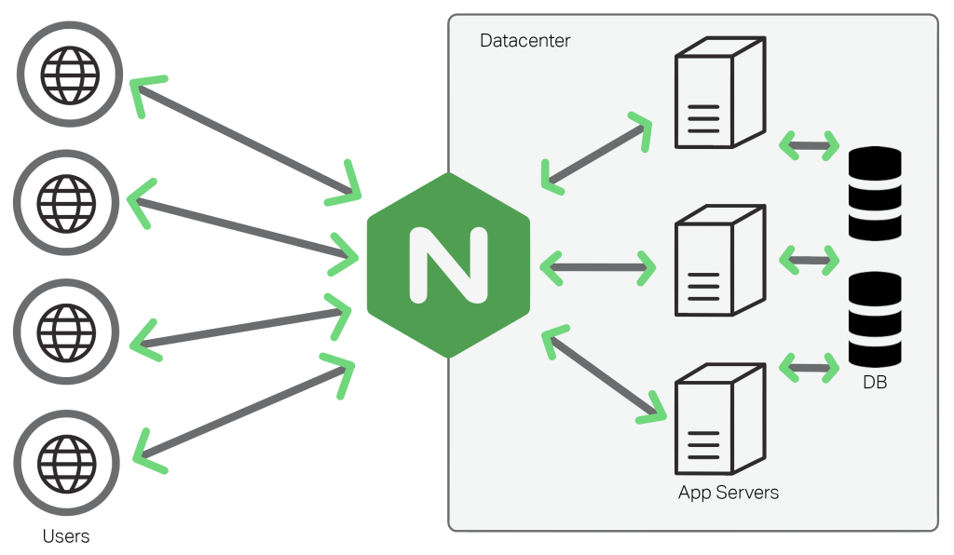
Nginx

Slide 74
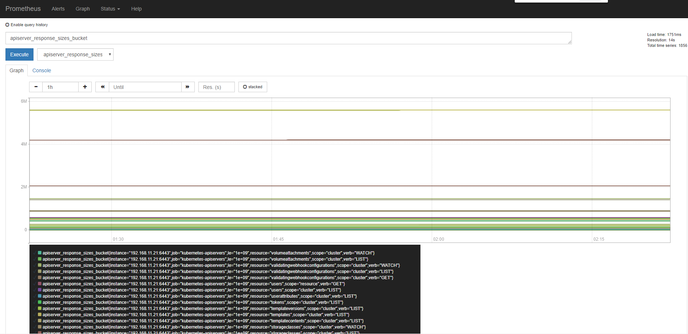
Prometheus

Slide 75
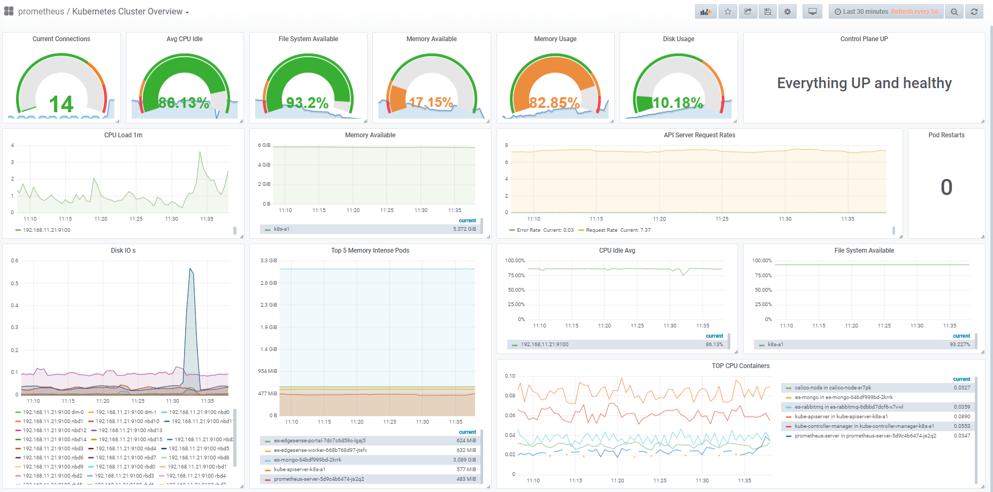
K8s Cluster Overview

Slide 76
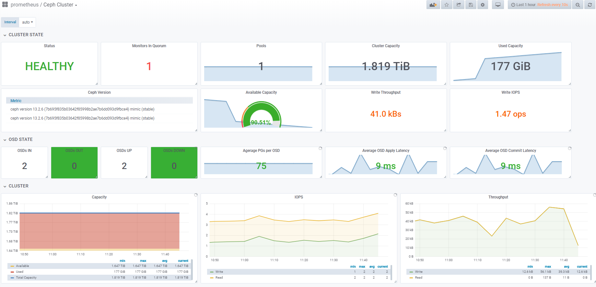
Ceph Cluster

Slide 77
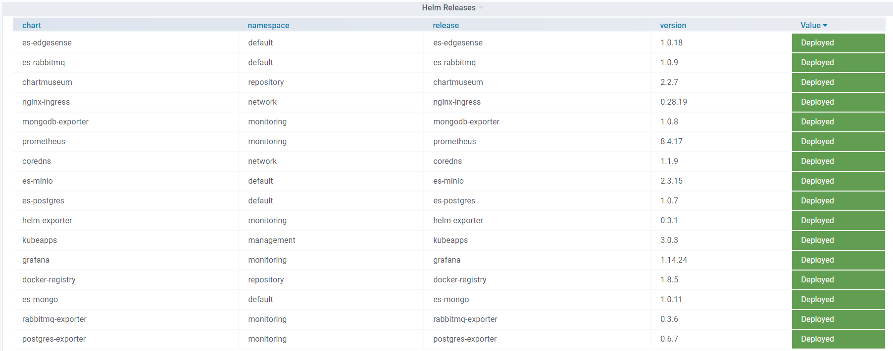
Helm Releases

Slide 78
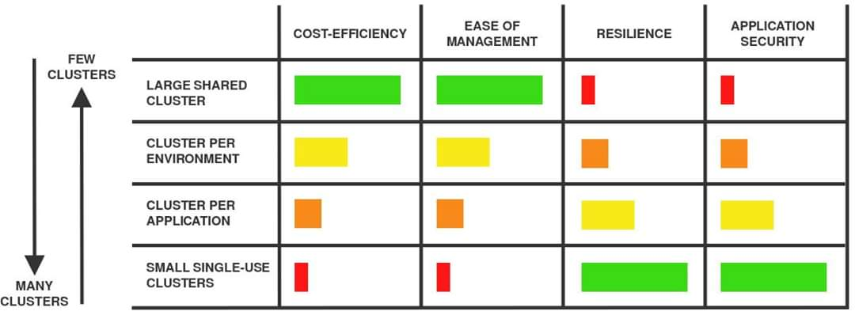
Specials

Slide 79
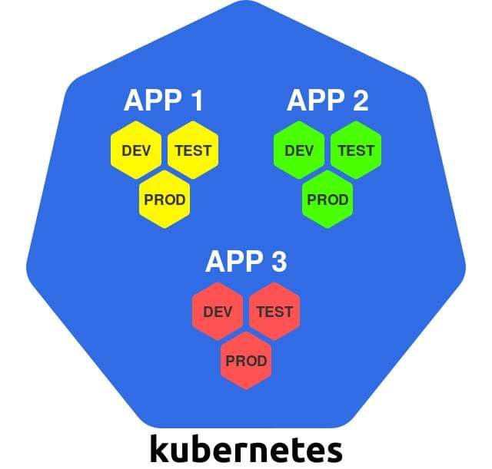
Specials

Slide 80
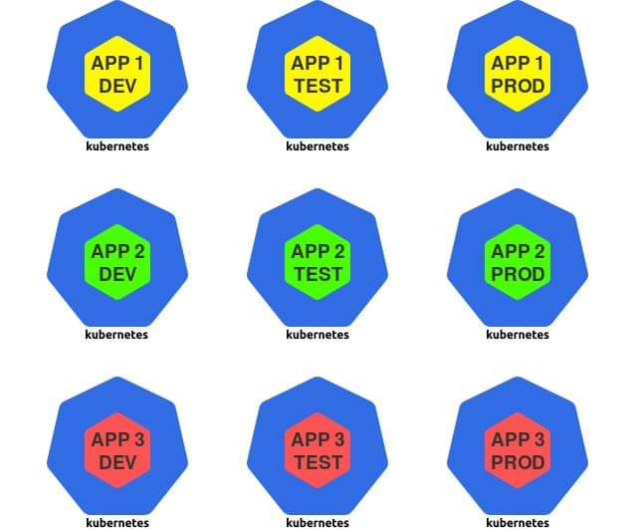
Specials

Slide 81

Specials

Slide 82

Specials

Slide 83
Specials - Types of Testing
Unit Testing
Test an individual software component or module.
Integration Testing
Test all integrated modules to verify the combined functionality after integration.
End to End (E2E) Testing
Test end-to-end behavior of the system.
Conformance Testing
determines whether the system complies with requirements of specifications and conditions, regulations and standards, etc.

Slide 84
Specials - SIG
A Special Interest Group (SIG)
a community within a larger organization with a shared interest in advancing a specific area of knowledge, learning or technology where members cooperate to affect or to produce solutions within their particular field, and may communicate, meet, and organize conferences.

Slide 85
Specials
Kubernetes SIGs
Kubernetes Community Governance Model
Kubernetes SIGs and Working Groups
Subprojects
Every part of the Kubernetes code and documentation must be owned by some subproject. These subprojects will be delivered to different SIGs.
Subprojects of each SIGs

Slide 86
Specials – E2E Testing
Cluster E2E testing ensures consistent and reliable behavior of
Kubernetes API and catches hard-to-test bugs before user do.
test-infra provides an official tool - Kubetest, which is the interface for
launching and running e2e testing.

Slide 87

Specials - Kubetest Workflow

Slide 88


Slide 89



Slide 90



Slide 91


Gingo & Gomega
The e2e tests in kubernetes are built atop of Ginkgo and Gomega. Ginkgo is a Behavior-Driven Development (BDD) style Go testing framework, and the Gomega is a matcher library paired with Ginkgo.

Slide 92

Specials
Conformance Test Requirements Make sure your tests are proven to meet the conformance test requirements.

Slide 93

Specials

Slide 94
Conclusions
E2E testing is important for enterprise to integrate Kubernetes with their system and take care on their own.
We have to always do E2E testing before deploy applications and environment into production.
Regular E2E/Comformance Test are the must-to-have things not best-to-have things.
Further integration with CI/CD Pipeline.
Last but not the least, please don’t kick RDs down into the F**king hell of answering complaint calls. If not…. Never mind. ☺

Slide 95


Slide 96
Go Together,
We Go Far and Grow Big

